Slide 1

Simple Paging
‹#›
Notes:
‹#›
‹#›

Slide 2

Problems with contiguous memory management
Consider Ex:
Program 0
Program 1
Program 3
0
500
1500
2100
4100
Program 2
3k
1K
2K
‹#›
Notes:
‹#›

Slide 3
This new program how can get fixed in remaining free area without compaction.
Following are the solns:
a) Can program be broken in two chunks of 1k and 2k .
b) How can such scheme(point a) be managed
c) How can addresses can be generated from such two non-contiguous memory area.
d) How can problem of protection and sharing be solved.
Solution:
Two base register for two chunks belonging to process.
Each base register will hold start address of chunks.
Chunk A base register-500
ChunkB base register-2100
If n non-contiguous chunks, need n base register and n limit register
‹#›
Notes:
‹#›

Slide 4
Non-contiguous Real memory management
What should be size of chunks?
Solutions are:
1. Logical address space of a process can be noncontiguous; process is allocated physical memory whenever the latter is available
2. Divide physical memory into fixed-sized blocks called frames (size is power of 2, between 512 bytes and 8192 bytes)
3. Divide logical mry into blocks of same size called pages.
4. Keep track of all free frames
5. To run a program of size n pages, need to find n free frames and load program
6. Set up a page table to translate logical to physical addresses
Note:
There will be some internal fragmentation (removes external fragmentation)
‹#›
Notes:
‹#›

Slide 5
Simple paging:
Address Translation Scheme:
Address generated by CPU is divided into:
Page number (p)
Used as an index into a page table which contains base address of each page in physical memory
Page offset (d)
combined with base address to define the physical memory address that is sent to the memory unit
‹#›
Notes:
‹#›
‹#›

Slide 6
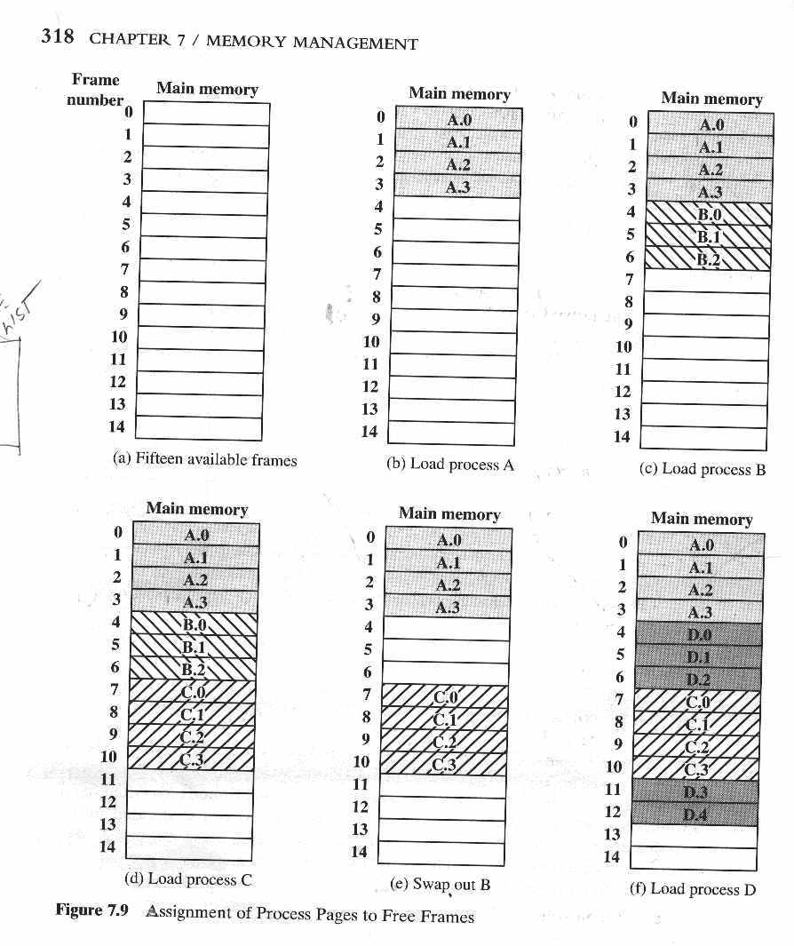
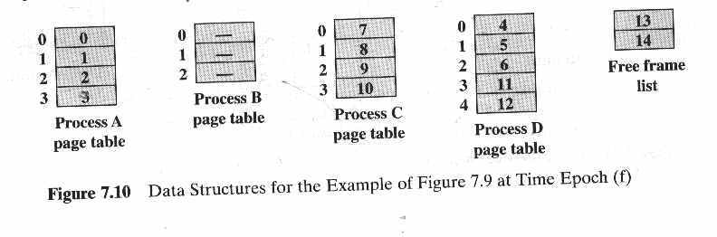
‹#›
Notes:
‹#›

Slide 7
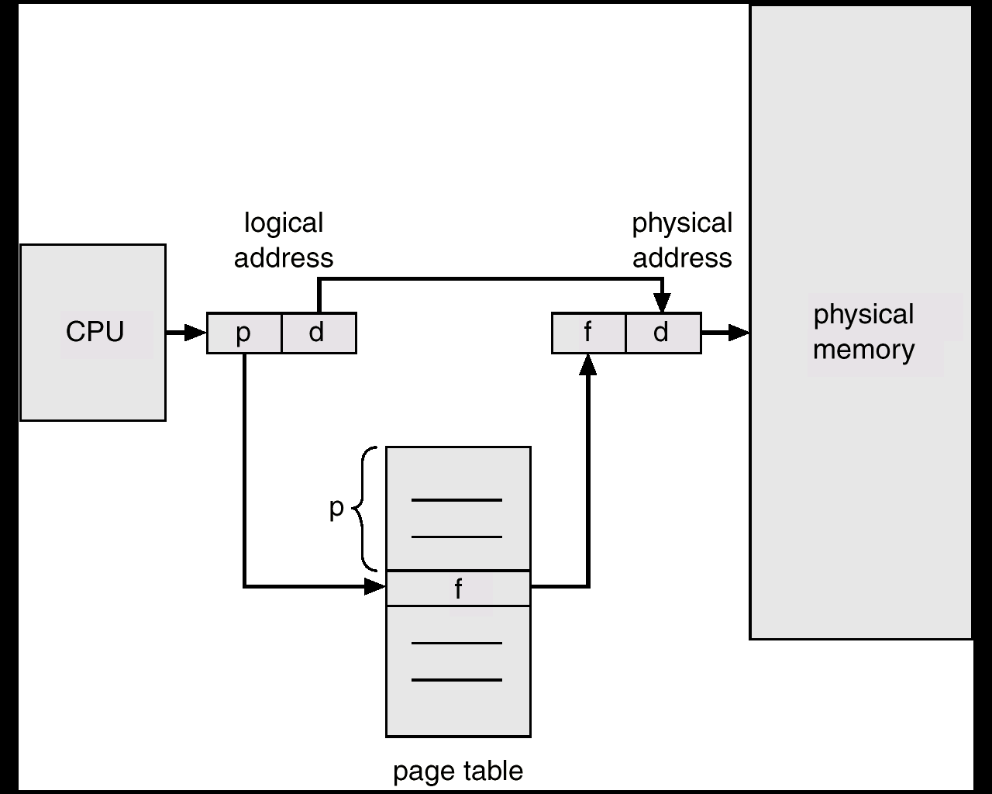
Paging Hardware
‹#›
Notes:
‹#›

Slide 8
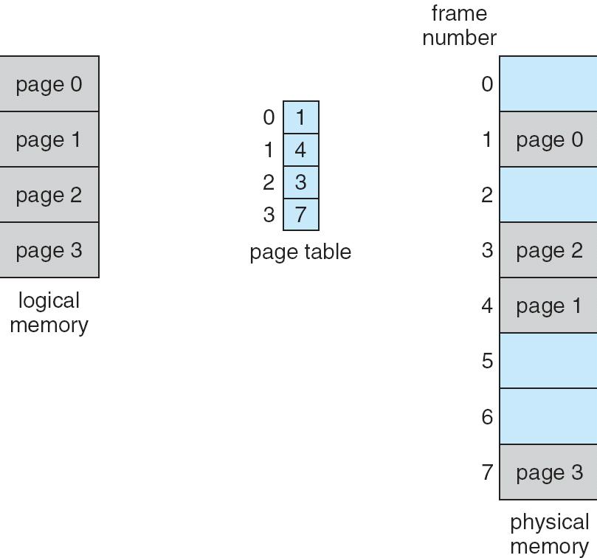
Paging Example
‹#›
Notes:
‹#›

Slide 9
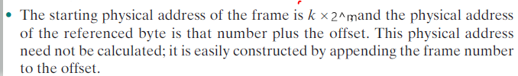
Steps of address translation
Following are the steps of the address translation

Slide 10
Paging Example-Logical to physical address translation
Ex:
16 bit addresses
Page size=1k
Consider relative address=1502
16 bit address= 0000010111011110
As Page size=1k
An offset field=10 bits
remaining will be 6 bits for page number.
Hence
1502 relative address corresponds to offset=478(0111011110) on page 1(000001) which corresponds to 16 bit address
‹#›
Notes:
‹#›

Slide 11
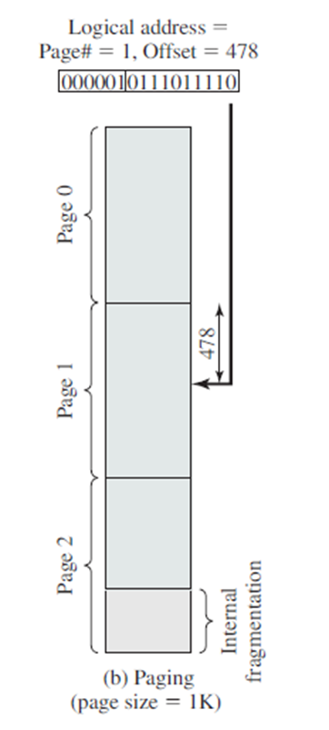
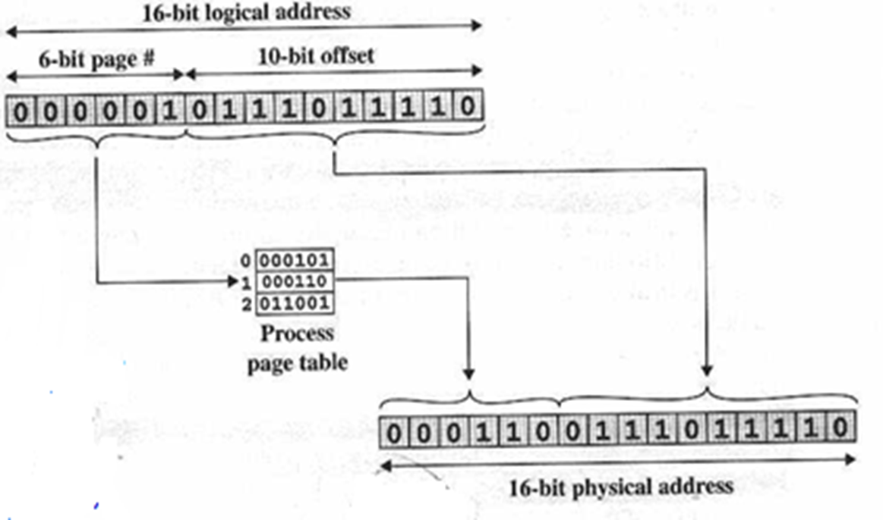
Paging Example-Logical to physical address translation
‹#›
Notes:
‹#›

Slide 12
Allocation algorithm
Memory allocation algorithm implies two things:
1) Maintaining list of free page frames
2) Allocating page frames .
For allocating frames to a process 3 units coordinate among :
1) Information Management(IM)
2) Process Management(PM)
3) Memory Management(MM)
‹#›
Notes:
‹#›

Slide 13
Allocation algorithm
With Allocated page frames ,MM now signals to PM to load the process
MM maintains list of free page frames from page table
MM now
1. check list of free frames and allocate frame to process
PM now
1. loads process pages in page frames with help of IM
PM request IM for the size of the process
2.Update the status of page frame to “allocated” and makes PT for same process
2. Links PCB of that process in list of ready process
IM resolves path and finds size of the object file of the process
3. If no free frames then MM informs to PM to postpone the loading of the process
3. PCB maintains pointer to the starting address of PT
PM requests MM to allocate the memory of that size
This pointer is used for address translation process after the context switch
MM calculates no.
of frames to be allocated
(=process size)
‹#›
Notes:
‹#›

Slide 14
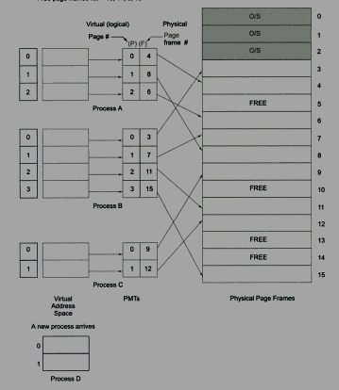
Free Frame list={10,14,5,13}
Process D has come
‹#›
Notes:
‹#›

Slide 15
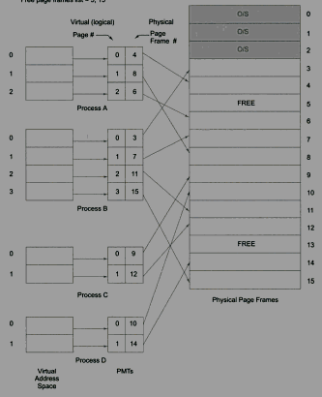
Free Frame list={5,13}
‹#›
Notes:
‹#›

Slide 16
Segmentation
‹#›
Notes:
‹#›
‹#›

Slide 17
What is Segmentation?
A user program and its associated data are divided into a number of segments.
Segments of all programs need not be same(they can grow or shrink)
Segments of program can get placed in non-contiguous way.
Hence segmentation results in external fragmentation but that should be less.
In segmentation, There is no direct relation between logical and physical address
‹#›
Notes:
‹#›

Slide 18
Simple Segmentation:
Address Translation Scheme:
Address generated by CPU is divided into:
Segment number
Used as an index into a segment table which contains base address and length of each segment in physical memory
Segment offset
It is added with base address to define the physical memory address that is sent to the memory unit
‹#›
Notes:
‹#›
‹#›

Slide 19
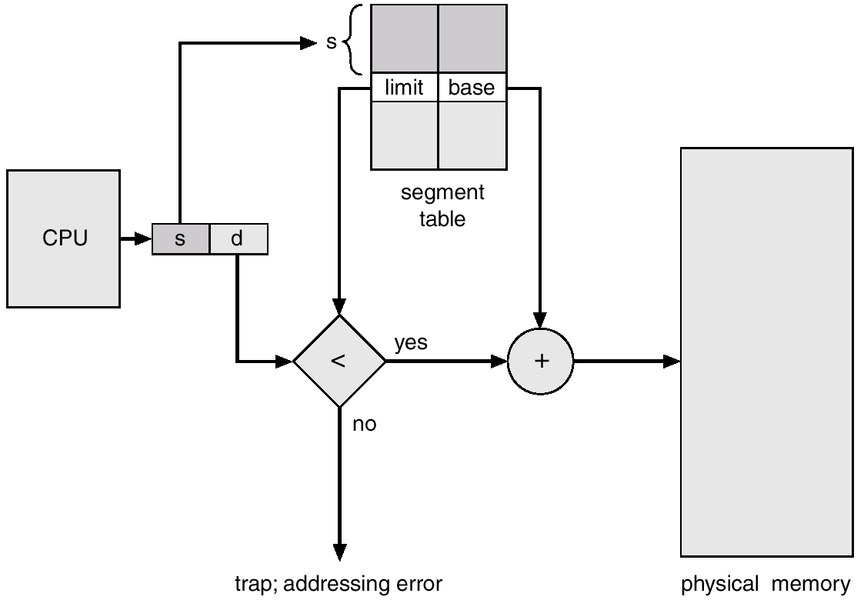
Segmentation Hardware
‹#›
Notes:
‹#›

Slide 20
Address translation in Segmentation?
Like paging in paging table ,in segmentation segment table for each process is used.
Segment table contains two fields :
1) Base address
2) Length
When a process enters in running state, address of its segment table get loaded in special register ,which is used by MM hardware.
Logical address consists of n+m bits ,where
n bits-segment no
m bits –Offset within the segement
‹#›
Notes:
‹#›

Slide 21
Address translation in Segmentation?
Example:
16 bit addresses
Segment size is 4k=4096
So offset get represents using 12 bits out of 16 bits and
remaining 4 bits will be used for segment no to represent.

Slide 22
Address translation in Segmentation?
Steps for address translation in simple segmentation is :

Slide 23
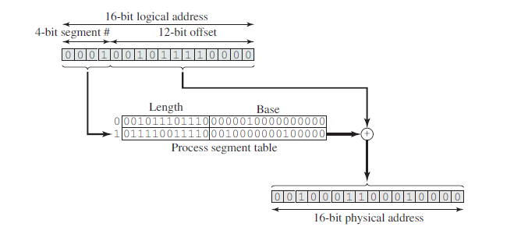

Slide 24
Virtual memory
‹#›
Notes:
‹#›
‹#›

Slide 25
Need of virtual memory
‹#›
When size of executable program ,data,stack(associated) exceeds the main memory size allocated for that process.
Hence OS keeps required parts of program in memory and rest is to be moved to disk.
Ex:32MB is size of a program can run in 8MB main memory area.
but when???
If it is known that which 8MB part of program is required at each time instant in memory for execution.
This is possible by swapping from disk to memory and vice versa
Notes:
‹#›

Slide 26
Background
‹#›
Virtual memory – separation of user logical memory from physical memory.
Only part of the program needs to be in memory for execution
Logical address space can therefore be much larger than physical address space
Allows address spaces to be shared by several processes
Allows for more efficient process creation
Virtual memory can be implemented via:
Demand paging
Demand segmentation
Notes:
‹#›

Slide 27
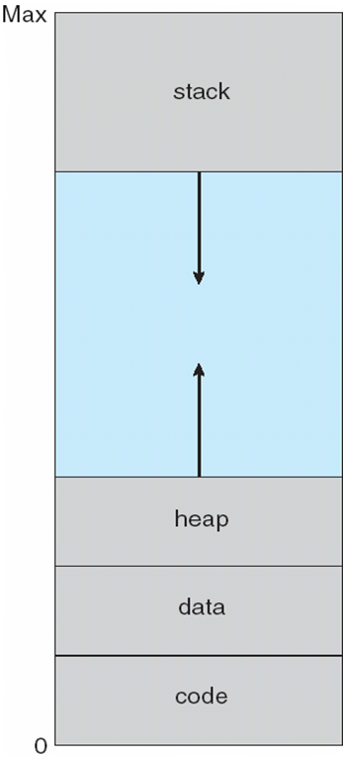
Virtual address space
‹#›
A virtual address space (VAS) or address space is the set of ranges of virtual addresses that an operating system makes available to a process.
The range of virtual addresses usually starts at a low address and can extend to the highest address allowed by the computer's instruction set architecture
Notes:
‹#›

Slide 28
Demand paging
Pages is brought in memory only when demanded.
This is done by:
Lazy swapper:
It never swaps a page into memory unless that page will be needed.
It manipulates entire process.
Pager:
It deals with individual pages of a process.
Hence pager is used for demand paging, is called as :
Swapper that deals with pages is a pager
‹#›
Notes:
‹#›

Slide 29
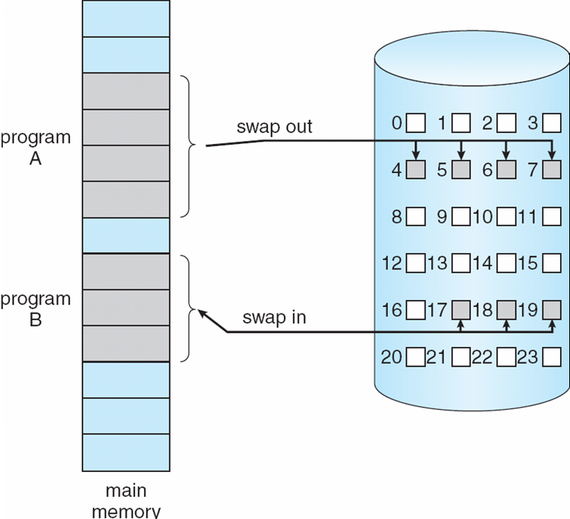
Demand paging
‹#›
Transfer of a Paged Memory to Contiguous Disk Space
Notes:
‹#›

Slide 30
Demand paging
‹#›
In demand paging, only some of the pages of a process may be in main memory.
Hence one bit is needed in each page table entry to indicate whether page is present in main memory or not
With each page table entry a present bit is associated
(p ⇒ 1 in-memory, p ⇒ 0 not-in-memory)
Initially p bit is set to 0 on all entries
Notes:
‹#›

Slide 31
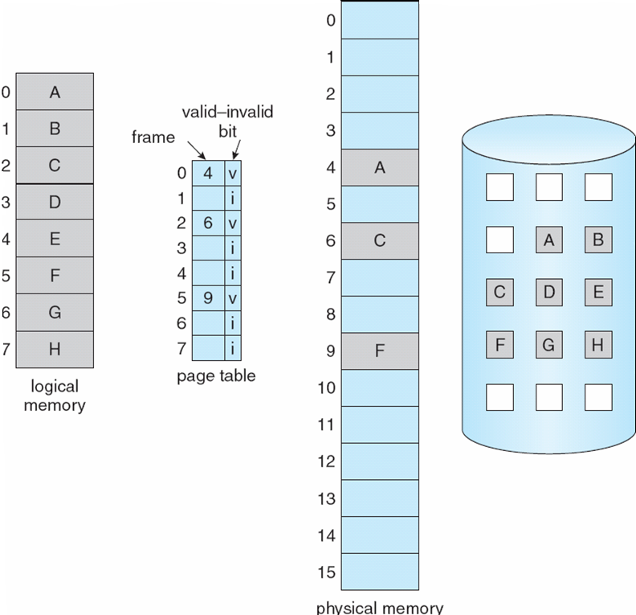
Page Table When Some Pages Are Not in Main Memory
‹#›
Notes:
‹#›

Slide 32
Virtual Memory Paging
‹#›
Notes:
‹#›

Slide 33
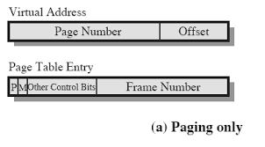
Paging with Virtual memory
1) A page table is also needed for a virtual memory scheme
2) page table entry with virtual memory are :
3)Here
P bit - indicates whether page is present in main memory
M bit - indicates whether page have been altered or not since the page was last loaded into main memory
Other control bits for managing protection or sharing
Notes:
‹#›

Slide 34
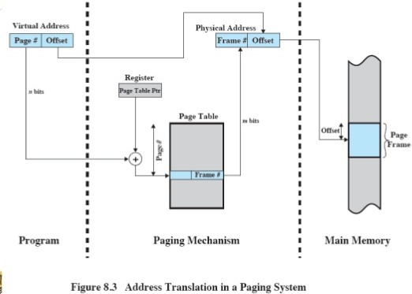
Address translation in a paging system
Notes:
‹#›

Slide 35
Formulas for paging
For Main Memory-
Physical Address Space = Size of main memory
Size of main memory = Total number of frames x Page size
Frame size = Page size
If number of frames in main memory = 2^{X}, then number of bits in frame number = X bits
If Page size = 2^{X} Bytes, then number of bits in page offset = X bits
If size of main memory = 2^{X} Bytes, then number of bits in physical address = X bits

Slide 36
Formulas for paging
For Page Table-
Size of page table = Number of entries in page table x Page table entry size
Number of entries in page table = Number of pages the process is divided
Page table entry size = Number of bits in frame number + Number of bits used for optional fields if any
For Process-
Virtual Address Space = Size of process
Number of pages the process is divided = Process size / Page size
If process size = 2^{X} bytes, then number of bits in virtual address space = X bits

Slide 37
Ex:Consider a machine with 64 MB physical memory and a 32 bit virtual address space. If the page size is 4 KB,
Calculate the following:
Number of Bits in Physical Address
Number of Frames in Main Memory
Number of Bits in Page Offset
Process Size
Number of Entries in Page Table
what is the approximate size of the page table?

Slide 38
Ex Contd..:
1. Number of bits in Physical address
Size of main memory= 64 MB
= 2²⁶ B
Thus, Number of bits in physical address = 26 bits
2. Number of frames in main memory
= Size of main memory / Frame size
= 64 MB / 4 KB
= 2²⁶ B / 2¹² B
= 2¹⁴
Thus, Number of bits in frame number = 14 bits

Slide 39
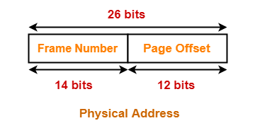
Ex Contd..:
3. Number of Bits in Page Offset-
We have,
Page size
= 4 KB
= 2¹² B
Thus, Number of bits in page offset = 12 bits
So, Physical address is-
4. Process Size-
Number of bits in virtual address space = 32 bits
Thus,
Process size
= 2³² B
= 4 GB

Slide 40
Ex Contd..:
5. Number of Entries in Page Table-
Number of pages the process is divided
= Process size / Page size
= 4 GB / 4 KB
= 2²⁰ pages
Thus, Number of entries in page table = 2²⁰ entries
6. Page table size
=Number of entries in page table x Page table entry size
= Number of entries in page table x
Number of bits in frame number
= 2²⁰ x 14 bits
= 2²⁰ x 16 bits (Approximating 14 bits ≈ 16 bits(including optional fields ))
= 2²⁰ x 2 bytes
= 2 MB

Slide 41
Implementation of Page Table
In this scheme every data/instruction access requires two memory accesses:
One for the page table and
One for the data/instruction.
Doubles memory access time!
The two memory access problem can be solved by the use of a special fast-lookup hardware cache called associative registers or translation look-aside buffers (TLBs)
‹#›
Notes:
‹#›
‹#›

Slide 42

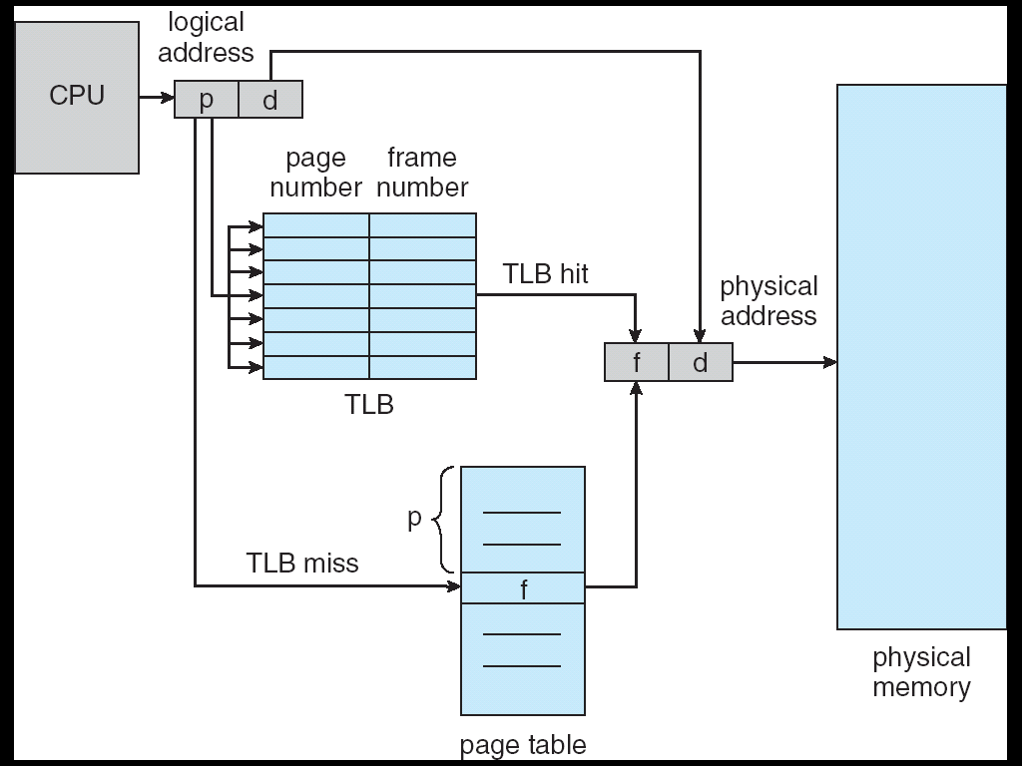
‹#›
Notes:
‹#›

Slide 43
Page fault
‹#›
If there is a reference to a page, first reference to that page will trap to operating system as a:
page fault trap
Notes:
‹#›

Slide 44
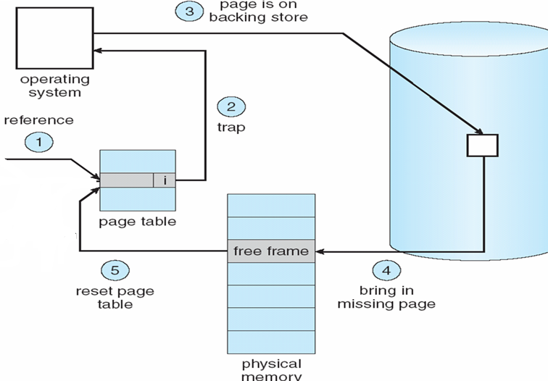
Steps in Handling a Page Fault
CPU checks TLB
NO
YES
CPU generates physical address
7
6
Restart instruction
Make same entry in TLB
Notes:
‹#›
‹#›

Slide 45
What happens if there is no free frame?
Page replacement –
Find some page in memory, but not really in use, swap it out
Using some page replacement algorithm
performance – want an algorithm which will result in minimum number of page faults
Same page may be brought into memory several times
Notes:
‹#›
‹#›

Slide 46
Page Replacement
Prevent over-allocation of memory by modifying page-fault service routine to include page replacement
Use modify (dirty) bit to reduce overhead of page transfers – only modified pages are written to disk
Notes:
‹#›
‹#›

Slide 47
Basic Page Replacement
Find the location of the desired page on disk
Find a free frame:
- If there is a free frame, use it
- If there is no free frame, use a page replacement algorithm to select a victim frame
Bring the desired page into the (newly) free frame; update the page and frame tables
Restart the process/instruction
Notes:
‹#›
‹#›

Slide 48
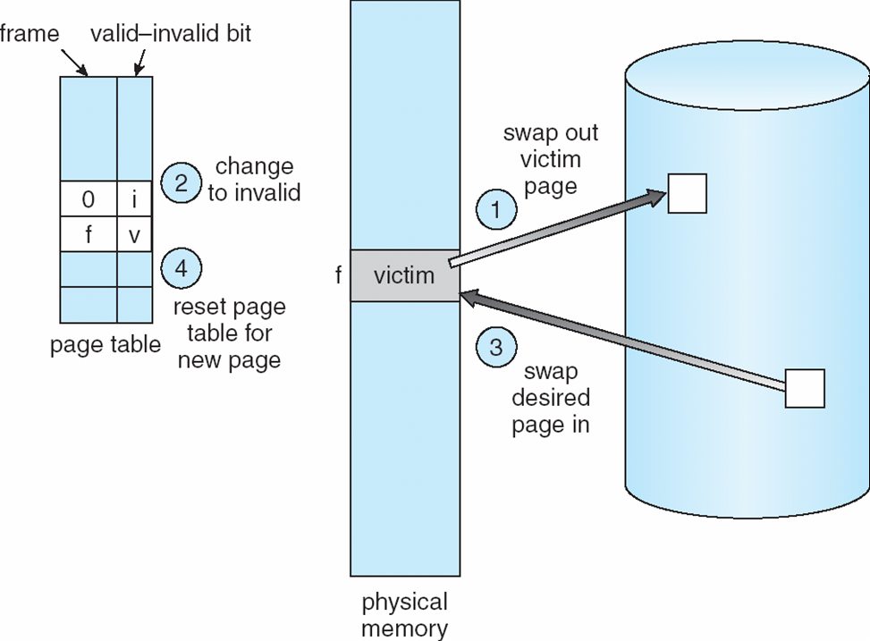
Page Replacement
Notes:
‹#›
‹#›

Slide 49
Page Replacement Algorithms
Want lowest page-fault rate
Evaluate algorithm by running it on a particular string of memory references (reference string) and computing the number of page faults on that string.
This page fault rate decides the which page replacement algorithm is best.
Notes:
‹#›
‹#›

Slide 50
FIFO Page Replacement
‹#›
Associates with each page the time when that page was brought into memory.
When a page must be replaced ,the oldest page is chosen.
Notes:
‹#›

Slide 51
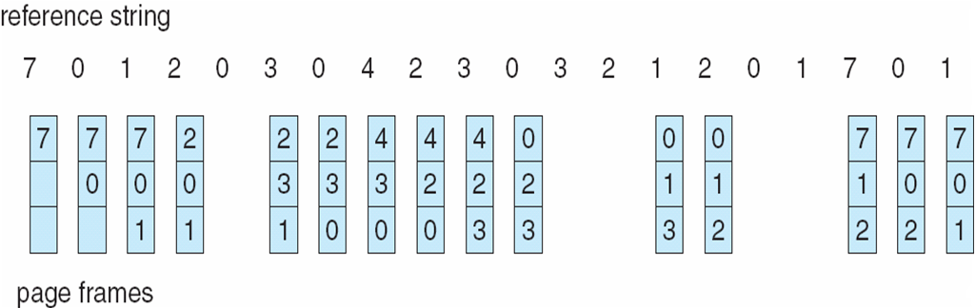
FIFO Page Replacement
No of Hits=5
Notes:
‹#›
‹#›

Slide 52
Optimal Algorithm
It replace the page that will not be used for the longest period of time.
This algorithm guarantees lowest possible page fault rate for a fixed number of frames.
Notes:
‹#›
‹#›

Slide 53
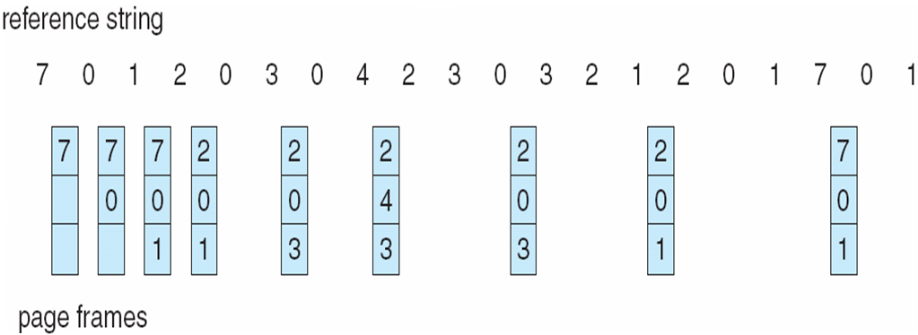
Optimal Page Replacement
No of Hits=11
Notes:
‹#›
‹#›

Slide 54
LRU algorithm
It replaces the page that has not been used for the longest period of time.
LRU algorithm associates with each page the time of that page’s last use.
Notes:
‹#›
‹#›

Slide 55
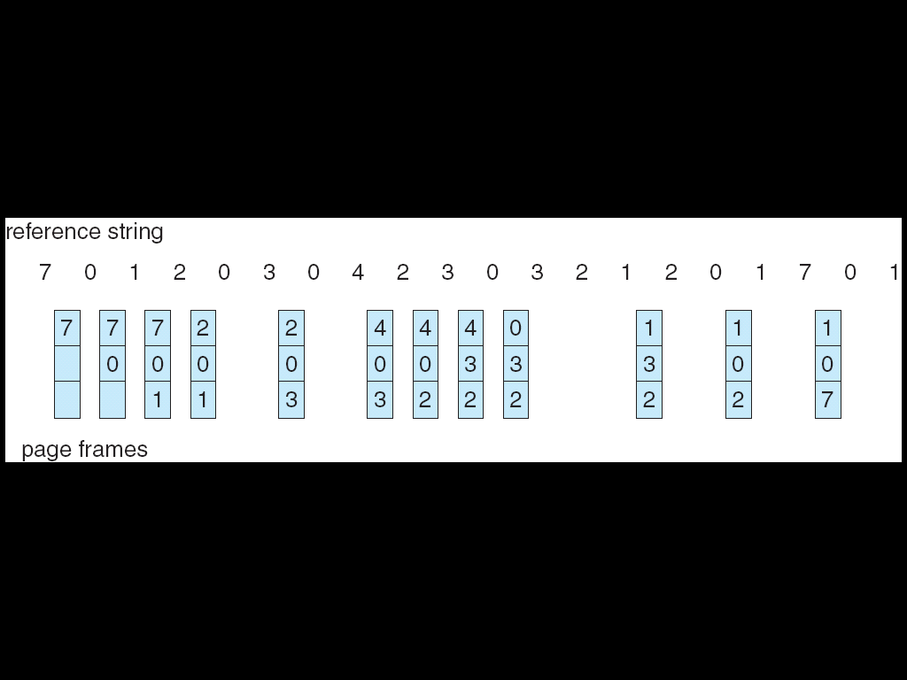
LRU Page Replacement
No of Hits=8
Notes:
‹#›
‹#›

Slide 56
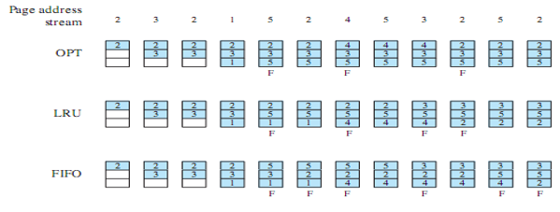
Combined example
‹#›
Notes:
‹#›

Slide 57
Page Size
Smaller page size, less amount of internal fragmentation
Smaller page size, more pages required per process
More pages per process means larger page tables
Larger page tables means large portion of page tables in virtual memory.
Secondary memory is designed to efficiently transfer large blocks of data, so a large page size is better

Slide 58
Page Size
Small page size, large number of pages will be found in main memory
As time goes on during execution, the pages in memory will all contain portions of the process near recent references .🡪 Page faults low.
Increased page size causes pages to contain locations further from any recent reference 🡪 Page faults rise.
So finally page size is related to the
size of MM,and
program size ,
address space used by applications is also growing
However most commercial OS support only one page ,Whereas multiple page size (settings of My computer) also can be set under the guidance of computer technician

Slide 59
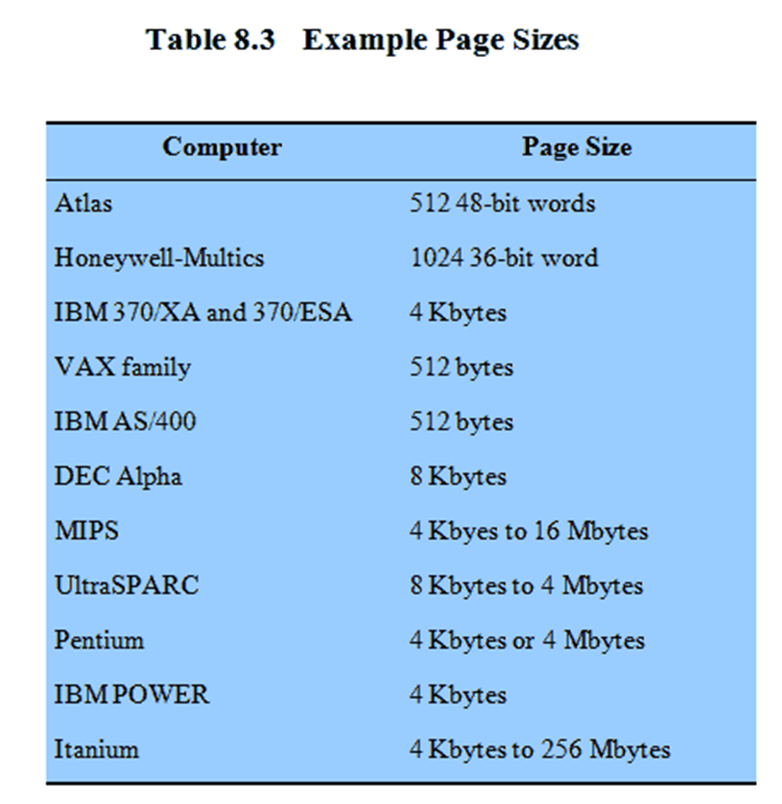
Example Page Size

Slide 60
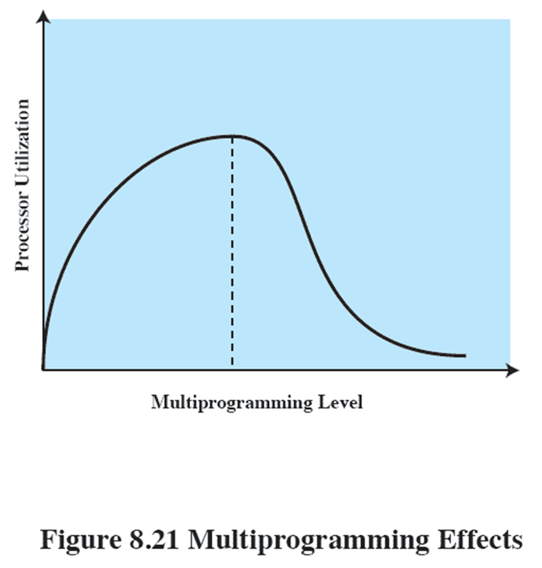
Thrashing
If a process does not have “enough” pages, the page-fault rate is very high. This leads to:
low CPU utilization
operating system thinks that it needs to increase the degree of multiprogramming
another process added to the system
Thrashing ≡ a processor is busy swapping pages in and out
‹#›
Notes:
‹#›

Slide 61
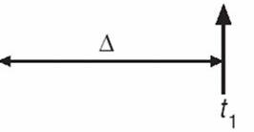
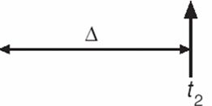
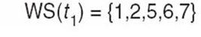
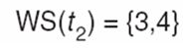
Thrashing
Hence to improve CPU utilization and one of the solution to the thrashing is the Working Set strategy.
It uses Δ, working set window.
It examines recent Δ page references.
If a page is in active use , then it will be in working set and
If it is no longer being use, then it will be dropped from the working set window.
Notes:
‹#›

Slide 62
Allocation of frames
Each process needs minimum number of pages
OS must decide how many pages to bring in,
i.e how much main memory to allocate to a particular process.
Factors:
1) Smaller main memory to a process, more no. of processes can reside in mm at any one time
2) Small no. of process pages is in memory , rate of page fault is high (Thrashing)
3) Additional allocation of main memory to a particular process will have no noticeable effect on page fault.
‹#›

Slide 63
Allocation of frames
‹#›
Fixed allocation:
It gives a process a fixed number of frames in main memory within which to execute.(Process creation time).
In case of page fault, page of same process is used for replacement(local scope)
Variable allocation:
It gives number of pages to be varied over the lifetime of the process.
Any page can be used for replacement(global scope)
Process with more page fault- gets more frames allocated
Process with less page fault-gets reduction in frame allocation

Slide 64
Allocation of frames
This allocation policy are associated with Replacement Scope.
This is called as Resident Set Management
Local Replacement | Global replacement
Number of frames allocated to process is fixed
Page to be replaced is chosen among the frames allocated to that process
Not possible
Fixed Allocation
Number of frames allocated to process may be changed time to time to maintain working set of a process
Page to be replaced is chosen among the frames allocated to that process
Page to be replaced is chosen from all available frames in main memory this causes the size of resident set of processes to vary
Variable Allocation

Slide 65
Virtual Memory Segmentation
‹#›
Notes:
‹#›

Slide 66
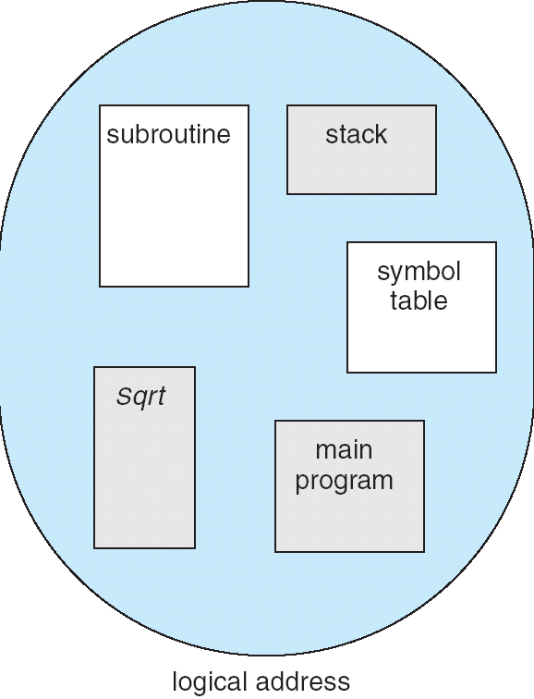
User’s View of a Program
‹#›
Notes:
‹#›

Slide 67
Logical View of Segmentation
1
4
1
2
3
4
2
3
user space
physical memory space
‹#›
Notes:
‹#›

Slide 68
Segmentation
Memory-management scheme that supports user view of memory.
A program is a collection of segments. A segment is a logical unit such as:
main program,
procedure,
local variables,
global variables,
common block,
stack,
symbol table, arrays
‹#›
Notes:
‹#›

Slide 69
Allocation steps
MM keeps list of free memory area
MM module now allocates free memory area to different segments
For any new process
PM module gives signal to IM for 2 things:
1.to get size of segment
2.no. Of segments
After memory allocation
MM builds ST or SDT
This information passed to MM module by IM
‹#›
Notes:
‹#›

Slide 70
Address translation for segmentation
Logical address consists of a two tuple:
<segment-number, offset>,
Segment table – maps two-dimensional physical addresses; each table entry has:
base – contains the starting physical address where the segments reside in memory
limit – specifies the length of the segment
Segment-table base register (STBR) points to the segment table’s location in memory
‹#›
Notes:
‹#›

Slide 71
Segment Tables
Starting address corresponding segment in main memory
Each entry contains the length of the segment
A bit is needed to determine if segment is already in main memory
Another bit is needed to determine if the segment has been modified since it was loaded in main memory

Slide 72
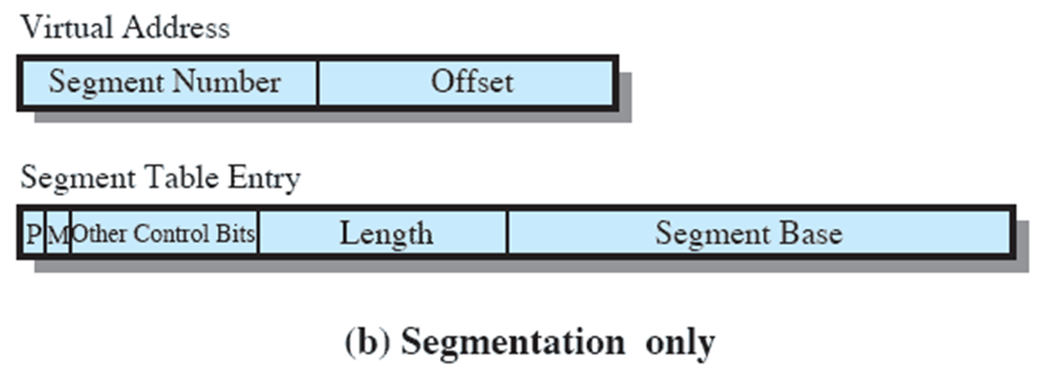
Segment Tables

Slide 73
Segmentation Hardware
‹#›
Notes:
‹#›

Slide 74
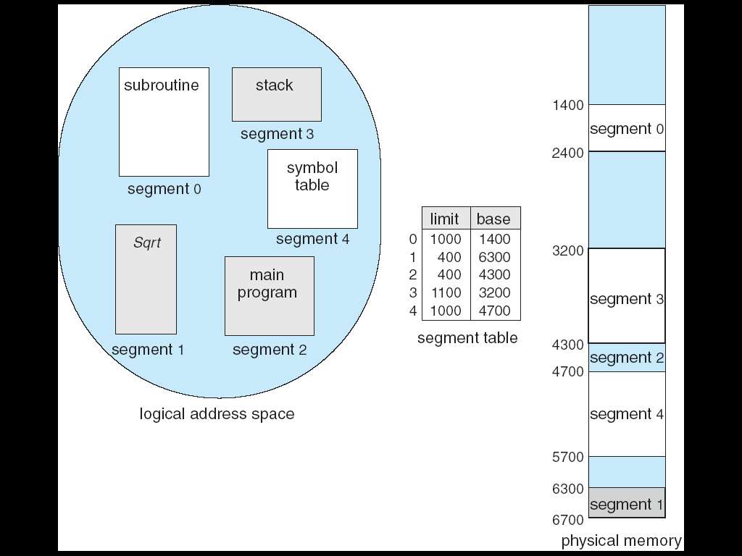
Example of Segmentation
‹#›
Notes:
‹#›

